Slide 1
Control systems
KON-C2004 Mechatronics Basics
Raine Viitala 5.11.2024

Slide 2
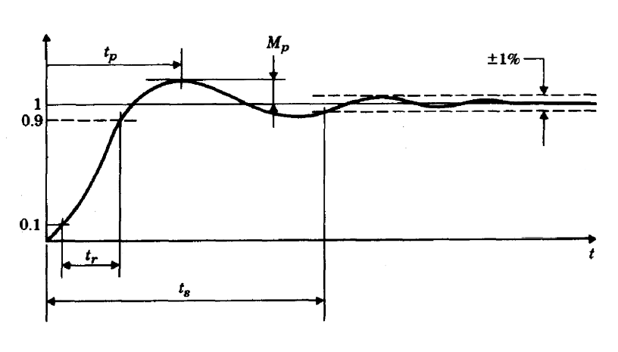
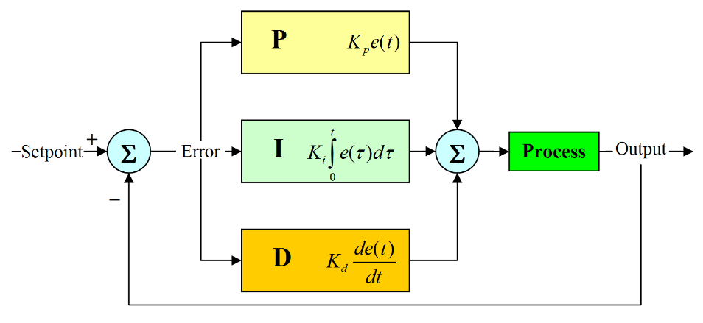
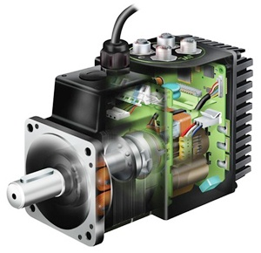
Lecture topics & learning outcomes
System modeling and response
Know what system modelling is and analyse responses in simple cases
Open & closed loop control
Understand the difference between open and closed loop control
PID controller
Understand and trial and error tune PID controller
Servo motors
Know what servo motor is
Notes:
Control system design is highly mathematical, but every engineer needs to understand the basics.
Understanding PID controller operation is important.

Slide 3
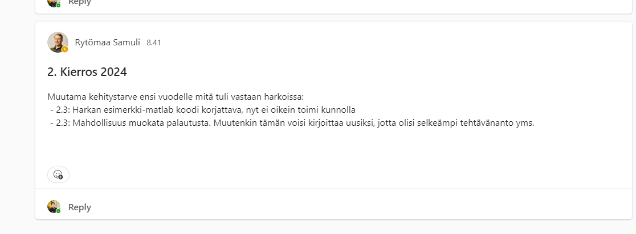
Feedback – thank you (10h – in line with previous years)
Exercises were fun and good. I learned a lot so that was good. However, there was some mistakes in the given matlab code ( last exercise Question 6) this caused unnecessary trouble, which did not result to any learning, when trying to do the exercise. Nice round still!
The modeling a DC motor was actually really fun. Doing all the calculations is fun but now shit gets real when I for once have to explain the calculating aswell. But I suppose its a good thing that you finally need to connect your calculations to the real world.
The task description of 2.3. was a bit all over the place, it would be nice to have the description in a more concise format like: simulate this and that - here are the known parameters.
Started to get quite interesting with the simulink tasks. Overall quite enjoyable but time-consuming.
Decent exercises 💀
This week exercises were difficult to understand , personnaly I do not enjoy writing long justifications i would rather prefer do calculations and simulations. The motor simulation was very intersting.
I need to start doing these exercises on friday so that I can attend the exercise seassions on monday if I get any problems. Other wise it was a fun week although tough
Is simulink an often used tool in worklife? Which is best matlab, maple or mathematica?
Really interesting, but very long for a weekly exercise, might be good for a two weeks period.
Quite hard exercises
Why even bother giving feedback when it is just rejected anyway? :P
This week definitely was a challenge and took a lot of time as u promised. Although I spent couple of hours just being stuck with simulink and getting all the values needed. Learned alot.
Yoooo dawggg???
Good exercise round, if a bit tedious. The only problem was in the question six (performance curves) where I found the directions to be a bit lacking of what exactly was asked to do (though I think I got it in the end).
I like these type of Matlab/Simulink exercises to this was quite fun

Slide 4
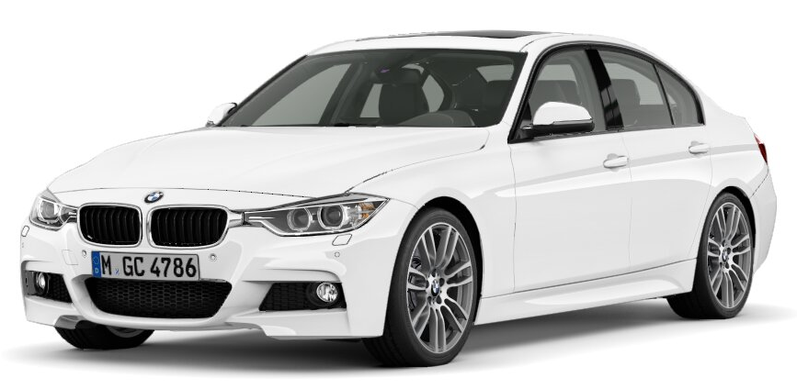
Mechatronic machine - subsystems
Controlling
computer
User Interface
Sensors
Signal
processing
Communication
(Bus, IoT, 5G)
Actuators
Controller
Affect and sense the physical world
Other systems and machines

Slide 5
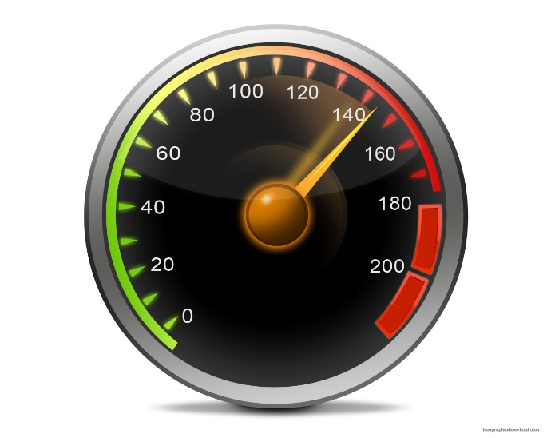
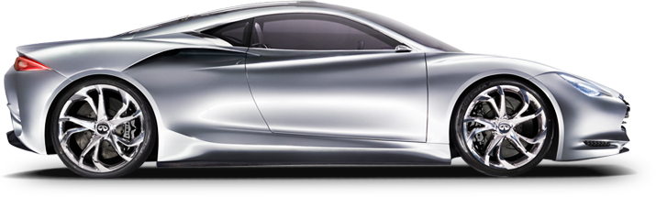
Example
Notes:
You want to accelerate a car to a certain speed, lets say 100 km/h. The gas pedal controls the torque produced by the motor and there is friction and air resistance in the system.
You can intuitively control the acceleration of the car with the gas pedal but how would you convert that intuition to a mathematical control algorithm?
Control theory is a field of science which tries to produce the optimal equation between the error signal and the input to the process.
Error signal = difference between the desired state and the actual state of the system.
Control system is a system or a device that manages the behavior of another system or device. Used to get the best performance of the system.
Car cruise control
Heater thermostat

Slide 6
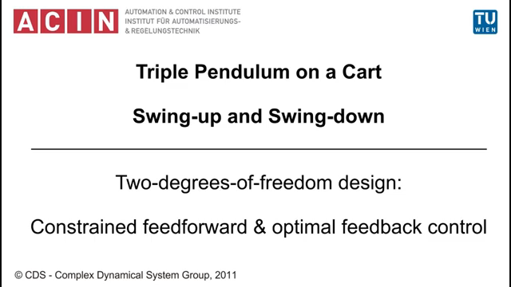
Triple inverted pendulum
No actuators in rotational joints, only angle measurement
Notes:
https://www.youtube.com/watch?v=cyN-CRNrb3E
Journal paper: https://ac.els-cdn.com/S000510981200605X/1-s2.0-S000510981200605X-main.pdf?_tid=f57571ae-c557-11e7-b939-00000aab0f02&acdnat=1510236912_8fd536915c476de620ba04ef32bd97f1

Slide 7
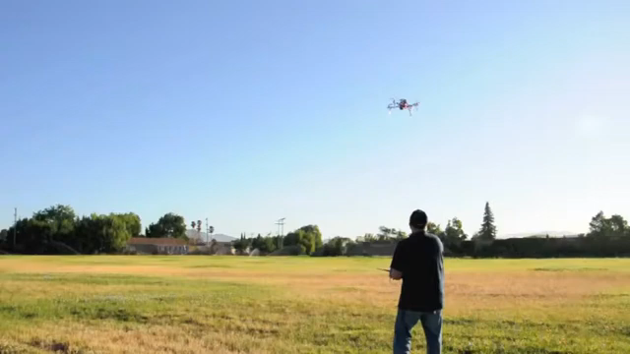
Unstable controller
Notes:
https://www.youtube.com/watch?v=c8uC54KMkfY&list=PLJ9OhXL8myuu4ZBxHhi4suuT_5WdNTmd8

Slide 8
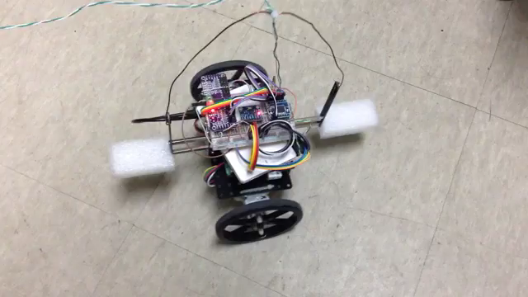
Unstable controller 2

Slide 9
System response

Slide 10
System
System / Plant / Process
Input
Output
Notes:
To analyze the behaviour of a system we need a model of it, or have measurements of it.
Typically machine building starts with months of modeling before anything physical is built.
Plant, process, system often mean the same thing.

Slide 11
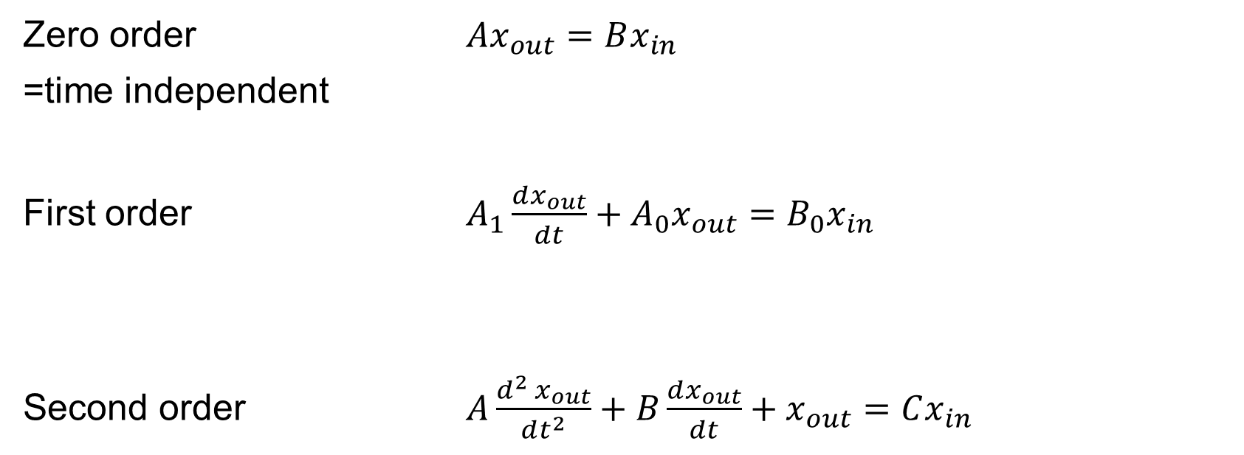
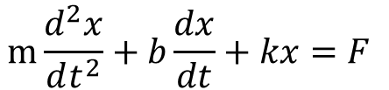
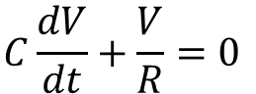
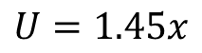
Mathematical models of systems
Zero order ${Ax}_{out}=Bx_{in}$
=time independent
First order ${A_{1}\frac{dx_{out}}{dt}+A_{0}x}_{out}=B_{0}x_{in}$
Second order ${A\frac{d^{2}{ x}_{out}}{dt^{2}}+B\frac{dx_{out}}{dt}+x}_{out}=Cx_{in}$
$$U=1.45x$$
Ideal sensor
$$C\frac{dV}{dt}+\frac{V}{R}=0$$
RC-circuit
$$m\frac{d^{2}x}{dt^{2}}+b\frac{dx}{dt}+kx=F$$
Notes:
Systems can be modelled with differential equations.
Zero order : Time independent.
Ideal transducer. Linear relationship between input and output.
Ideal sensor.
First order: Constant rate of change
RC circuit, LR circuit.
Population of bacteria.
Thermal transfer.
Second order: F=ma+bv+kx

Slide 12
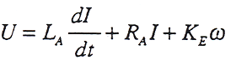
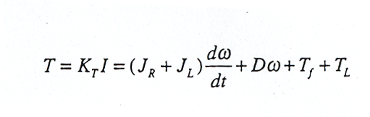
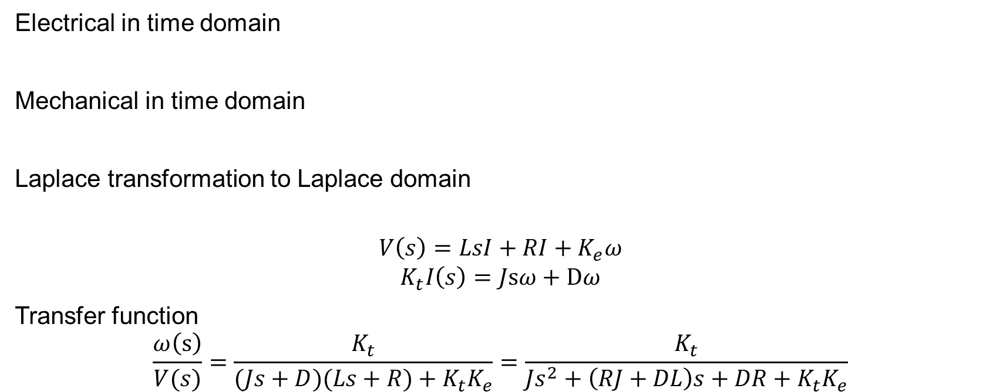
Firsto order system: DC motor in terms of angular velocity Laplace analysis to solve differential equations in analytical form
Electrical in time domain
Mechanical in time domain
Laplace transformation to Laplace domain
$$V\left(s\right)=LsI+RI+K_{e}ω$$
$$K_{t}I\left(s\right)=Jsω+Dω$$
Transfer function
$$\frac{ω\left(s\right)}{V(s)}=\frac{K_{t}}{(Js+D)(Ls+R)+K_{t}K_{e}}=\frac{K_{t}}{Js^{2}+\left(RJ+DL\right)s+DR+K_{t}K_{e}}$$
Notes:
RLC circuits, spring-mass-damper. Models like this can also be used to present and predict also economic systems etc.
Differential functions are difficult to solve in time domain, so in analytical analysis they are transformed to Laplace domain enabling the manipulation with algebra.
Transfer functions are used for linear systems, and may not exist for nonlinear models. For example Simulink models can be used for any kind of systems since they are solved numerically by iterating, not analytically.
Usually systems are assumed to be linear or nonlinear systems are linearized at some operating point.
Characteristic function is the denominator of transfer function. It contains most of the dynamics of the system. If any of its coefficients are negative, the system is unstable. The system can be unstable even if all the coefficients are positive.
For example a DC electric motor can not be naturally unstable, it would mean negative resistance, inertia, inductance or damping.
Step responses of general different order systems shown. Matlab ”tf” is used to create the transfer function and ”step” function to show the step response.

Slide 13
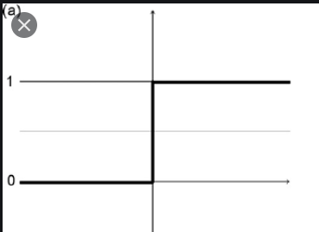
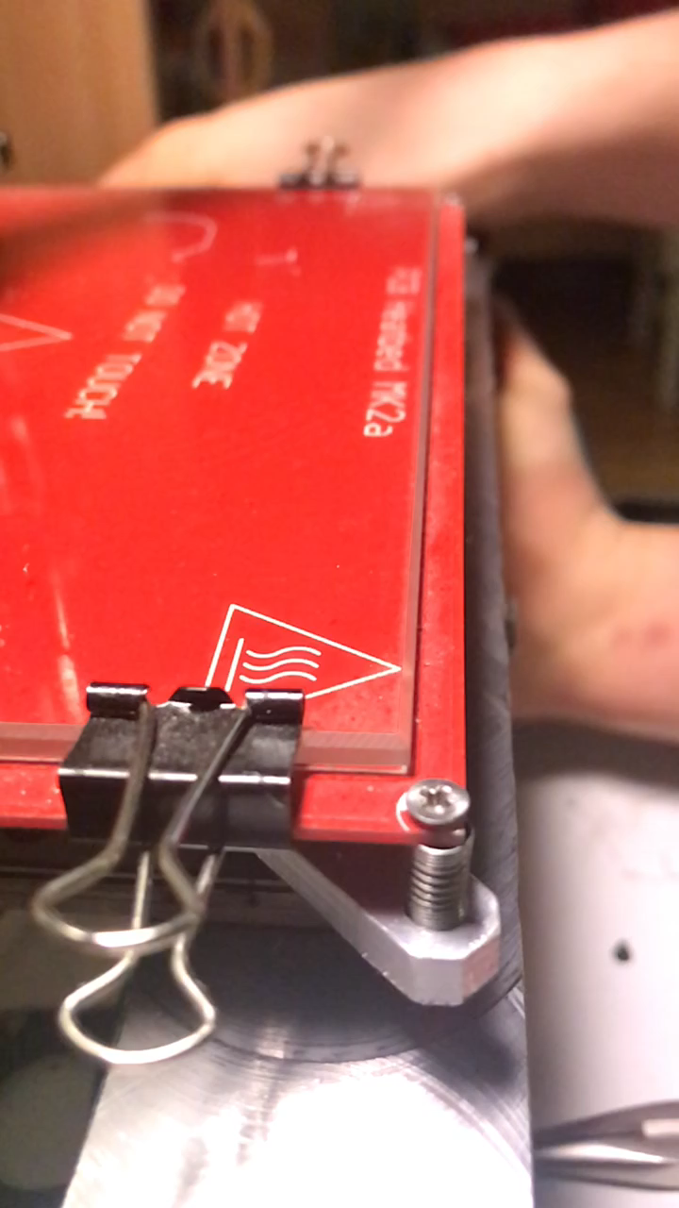

Step response of a system
This is what we put in
Overshoot
Steady state
Rise time
Settling time
Notes:
A tolerance band for the settling time can vary. Sometimes 10 %, sometimes 0.1 %.
Rise time definition also varies 10-90 %, 0-95 % etc.
This is the response of an underdamped system because there is overshoot.
Also impulse responses are often used as test inputs.

Slide 14
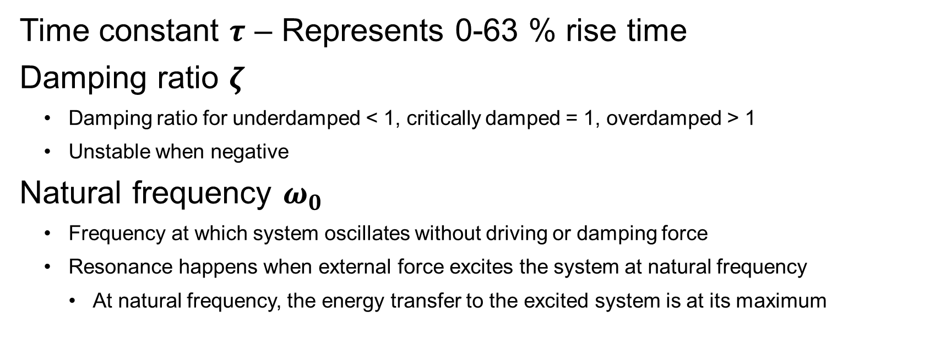
Parameters
Time constant $τ$ – Represents 0-63 % rise time
Damping ratio $ζ$
Damping ratio for underdamped < 1, critically damped = 1, overdamped > 1
Unstable when negative
Natural frequency $ω_{0}$
Frequency at which system oscillates without driving or damping force
Resonance happens when external force excites the system at natural frequency
At natural frequency, the energy transfer to the excited system is at its maximum
Notes:
These parameters can be seen from the transfer function. (Outside the scope of this course.)
Damping ratio zeta describes the ratio of the system’s damping and critical damping.

Slide 15

Resonance
Notes:
Tacoma bridge 1940.

Slide 16

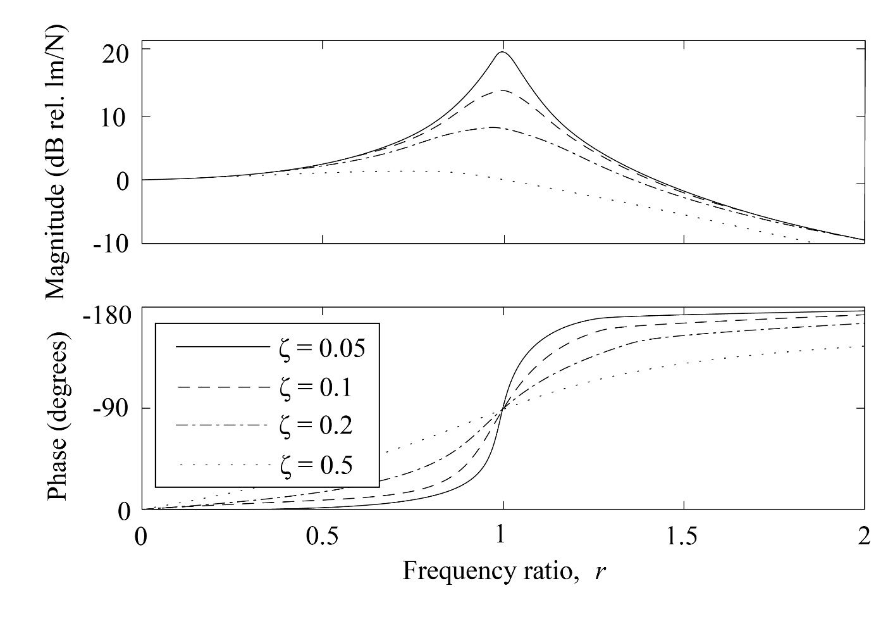
Resonance 2

Slide 17
System damping
Notes:
Draw the step.
Step response of a second order linear system
Unstable when the oscillation grows without limit. Damping ratio is then negative.

Slide 18
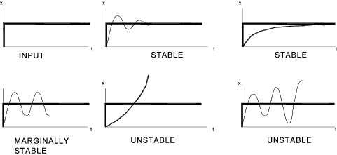
Stability
System is stable when bounded input always causes a bounded output
Problems are caused by
Inherently unstable systems
Unstable controller
Delay in control loop
Too high control gains
Positive feedback
Notes:
System is unstable when is output goes to infinity when time increases. A marginally stable system oscillates until infinity but the oscillation amplitude does not increase. A stable system reaches a steady output in time.
Unstable car velocity control system: small movement of gas pedal causes infinite acceleration or constantly increasing velocity variation.
Some systems are naturally unstable, for example fighter planes are designed to be aerodynamically unstable to improve their maneuverability. They need constant correction from a controller which makes the combination system stable. A human could not control a fighter plane manually in high velocity.

Slide 19
Control systems

Slide 20
Requirements for a control system
The output of the process follows the desired value with some
Steady state accuracy
Transient accuracy
Time constant, overshoot
Stability
And the controller requires reasonable
Computational effort
Amount of knowledge of the process
Effort to tune
Notes:
Also robustness.
Often a compromise between response time and stability.

Slide 21
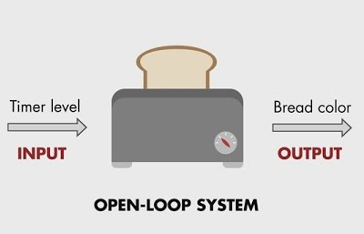
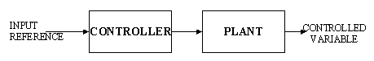
Open loop control
Controlling the process without a knowledge of its state
Controller always stable
Does not reject disturbances
External forces
Aging of devices (change in friction) etc.
Changes in environment (temperature etc)
No sensors required
Notes:
Feedback measurement might be expensive or impossible. For example in a washing machine it would be difficult to measure the cleanliness of clothes.
Hand brake in a car is open loop control. Normally you do not pull it all the way up. In a steep slope you pull it tighter and assume that the car keeps its position.
Example: Most 3D printers use open loop position control (stepper motors) but closed loop temperature control in printer bed and head
Plant = process.

Slide 22
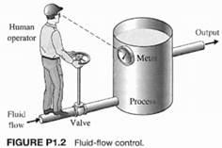
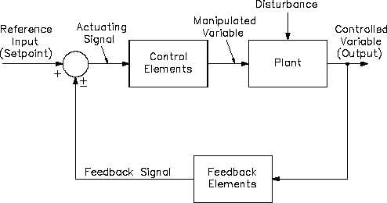
Closed loop (feedback) control
Modifying the control signal using information of the current output of the process
Negative feedback stabilizes system
Notes:
Disturbance rejection
A measurement does not have to be a physical measurement, it can also be a model based estimator.
Regulator controller stabilises the output to a certain value.
Servocontroller forces the output to follow a time varying reference.

Slide 23
Closed loop (feedback) control
Modifying the control signal using information of the current output of the process
Negative feedback stabilizes system
Target value
+
controller
process
output
-
How to make this closed loop??
Notes:
Disturbance rejection
A measurement does not have to be a physical measurement, it can also be a model based estimator.
Regulator controller stabilises the output to a certain value.
Servocontroller forces the output to follow a time varying reference.

Slide 24
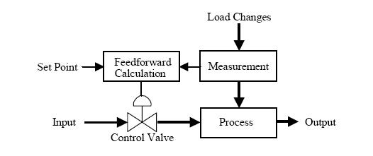
Feed forward control
Modifying the control signal according to some external parameters
Power steering in a car – speed affects in addition the the position
Notes:
Power steering in a car is also controlled by the speed of the car. Steering amplification depends on the speed but not the current steering angle.
If the process has delays, feed forward might be better than feedback. For example heating process can be slow and depends on the environment temperature.

Slide 25
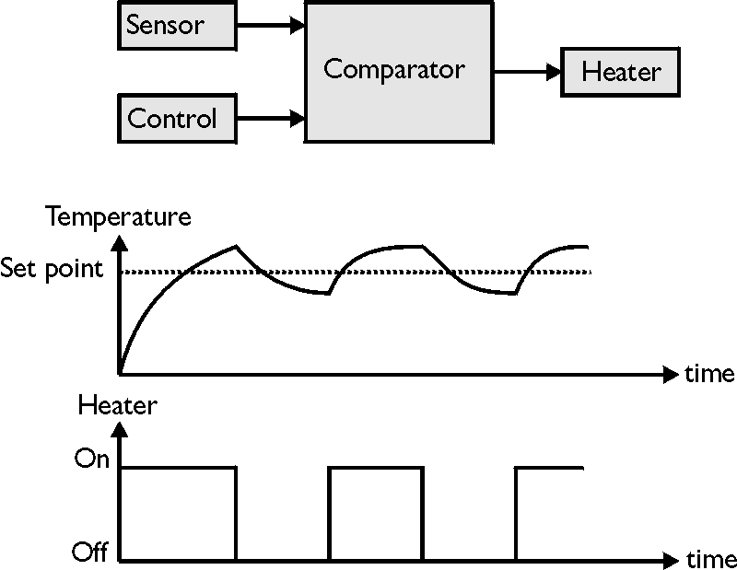
Bang bang controller
Actuator at full positive or negative power
Very simple and often fastest possible response
In some cases requires a system model for accuracy
Requires hysteresis to limit switching
Notes:
If an object has to be moved from one location to another, the fastest way to do this is to use maximal force for accelerating and for decelerating. If the object is a car, this is not a very comfortable method.
Works for a heater or an air compressor where the system has enough capacitance so that the output does not change quickly.
Does not handle steady state external loads well

Slide 26
PID controller

Slide 27
Back to the example
Notes:
You want to accelerate a car to a certain speed, lets say 100 km/h. The gas pedal controls the torque produced by the motor and there is friction and air resistance in the system.
One option is to push the gas pedal to some position that you know will give you the right speed. This would be open loop control.
The second option is to realize that you have a target speed and a current speed and there is a difference in them and you need to accelerate as long as there is a difference. This is closed loop i.e. feedback control.
If your torque is proportional to the error in speed, you will never reach the correct speed.

Slide 28
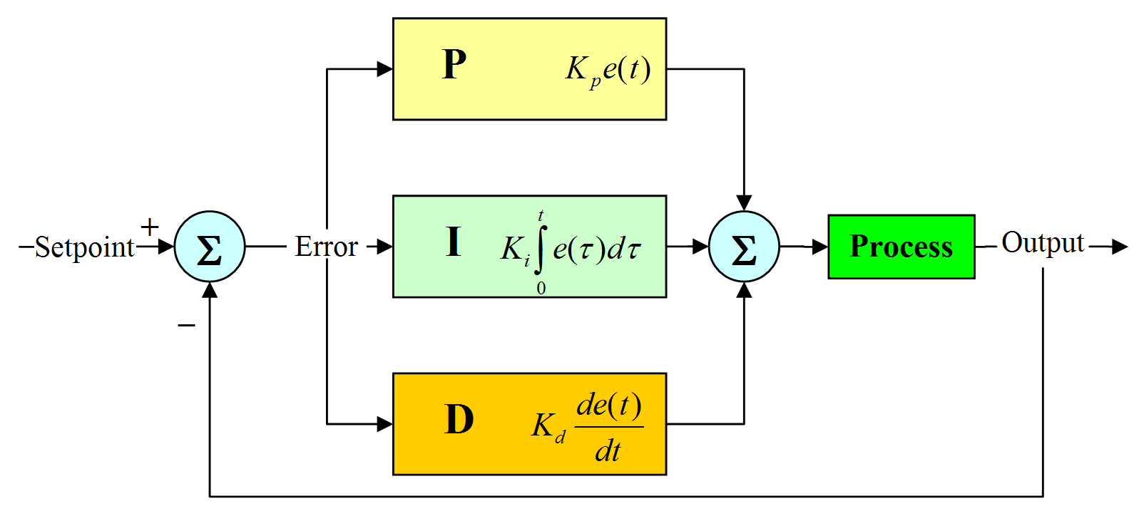
PID controller
Proportional, Integral and Derivative terms
Notes:
Most frequently used feedback controller.
Model based controllers yield better results but PID requires no knowledge of the controlled system. It is simply tuned.
The error signal is the difference between your desired speed and the measured speed. The output from the controller does not have a unit and it is not a command for the motor to move to some position or speed. The controller output controls the input for the actuator (voltage, pressure etc.) which creates a response which brings the position or the speed of the motor closer to the desired value.
A PID controller is normally a software component and a part of some embedded program.
Developed in US navy in the twenties by observing helmsmen who steer ships.

Slide 29
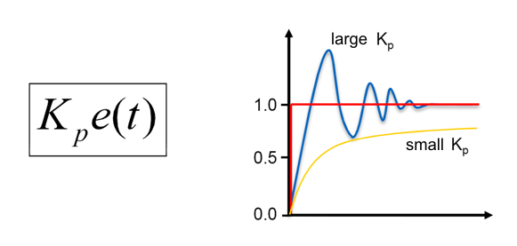
PID controller (P term)
Output proportional to error signal
Large gain K_{p} -> fast response, overshoot, oscillation
Small gain K_{p} -> slow response, large steady-state error
Notes:
Servo motor with speed control is an integrating process since it accumulates momentum (speed) from voltage.
Servo motor with position control is double integrating since is accumulates position from velocity. Double integrating processes do not necessarily have steady state error with P control.

Slide 30
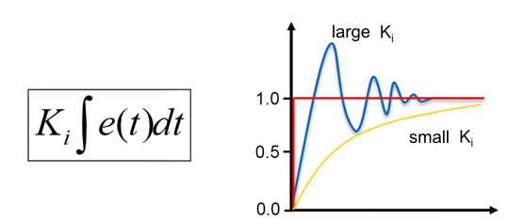
PID controller (I term)
Output proportional to time integral of error
Makes steady state error go to zero
Large K_{I} -> error decreases quickly, overshoot, oscillation
Small K_{I} -> error decreases slowly

Slide 31
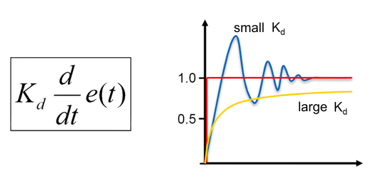
PID controller (D term)
Output proportional to change rate of the error
K_{d} can dampen the response
If signal is noisy K_{d} may increase the interference
Notes:
Derivative term is often left out because of noise issues.
Noise can be reduced with filtering but it adds some time delay and can cause stability issues.
A very high derivative gain increases settling time.

Slide 32
Parameter effects, warning, rough generalizations
 | Overshoot | Steady state error | Stability
K_{P} | + | - | -
K_{I} | + | -> 0 | -
K_{D} | - | - | +/-

Slide 33
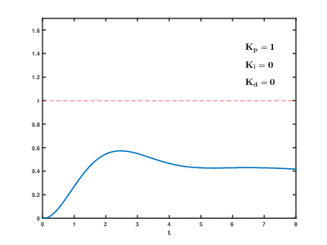
Parameter effects
Target value
This is what we put in
+
controller
process
output
-

Slide 34
Lecture task: PID-controller
Discuss in groups of 2-4 the operating principles of a PID-controller. If your colleague does not understand some part of it, teach!
Why PID is cool and nice in many engineering applications?
Negative feedback
Proportional part
Integral part
Derivative part
If there is something unclear, write it down, and I will try to answer

Slide 35
PID controller tuning
How to find the right gains?
Experimenting with a real system – might be dangerous
Apply input and observe
Experimenting with a system model – might be tedious
Simulink model – curves – adjust gains
Iterative optimization with a system model – requires cost function
For example a Simulink model with Matlab optimization functions
Analytical optimization with mathematical system model – might be difficult
Transfer function – calculus
Notes:
Tuning a PID controller is not a simple task to do properly. Series of books have been written on the subject.
Ziegler-Nichols: increase Kp until undamped oscillation. Take note of oscillation period and Kp gain…
Experimenting does not give optimal control results.
Optimizing requires also a well defined cost function which takes to account the error, effort and comfortability.

Slide 36
Example: Microcontroller code for PI controller
if(PID_on){
reference = read_adc(0)/4; //Read reference from a potentiometer
error = reference-speed; //Calculate error
proportional = P*error; //Proportional part of control
integral = integral + I*error; //Integral part of control
control = proportional+integral; //Controller output
if(control<0){direction = 1;}else{direction = 0;} //Choose motor direction
}
PORTB.3 = direction; //Write to direction register
OCR1A = control; //Write to PWM register
Notes:
You might have a situation where you would like to modify the controller somehow like adding a dead zone or uncontinuous limits to signals, but you need to be very careful with those. It often makes the situation just worse.

Slide 37
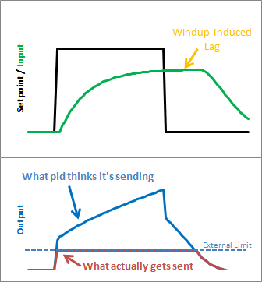
Actuator range and rate limitations
Real actuators have range and speed limitations
Actuator saturates -> modify control law
Anti-windup compensator
Limits integral growth
=Controller output
=Actuator output
Notes:
Usually a well behaving PID controller also requires some modifications in addition to the previous code.
A simulated system can behave arbitrarily fast because simulated actuators can produce very large forces without delay. Real actuators have limitations.
Antiwindup which limits the integral term when the actuator cant reach the desired reference value.
Jas Gripen crashed in Stockholm in 1993 because of missing anti-windup.
Complicated topic. PhDs and books written about anti-windup.

Slide 38
Analog vs digital controllers
Controllers implemented with digital devices do not work continuously
Analog controller can be implemented with operational amps
High frequency, integration differentiation, summing etc
Most controllers digital, some vefy fast control loops analog
Results slightly different in analog and digital controllers
Slightly different analysis methods
Notes:
Analog and digital controllers behave almost the same if control rate is large enough.

Slide 39
Control rate
In digital technology, not even time is continuous
All tasks are done at certain intervals
Measurements are either averaged or momentary
Control algorithm calculated at constant and small enough control intervals
Control rate depends on time constant of the system
Rise time from one state to another minimum 5-10 control loops
For a motor for example every 10 ms is often enough

Slide 40
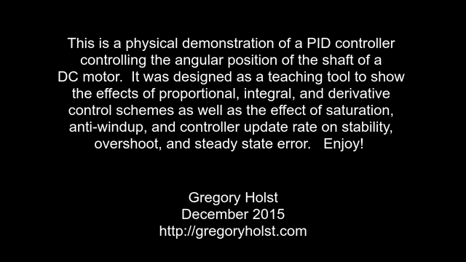
PID position control demo

Slide 41
Other controllers
Model-based control
Using a model of the system to predict its behaviour
Adaptive control
Modifying controller parameters according to output
Optimal control
Optimizing a controller to minimize a cost function
Robust control
Designing a controller that works with disturbances
Fuzzy control
Intuitive rule based controllers
Notes:
PID controller is not a model-based controller but it can be optimized and tuned based on the process model.

Slide 42
Servo motors

Slide 43
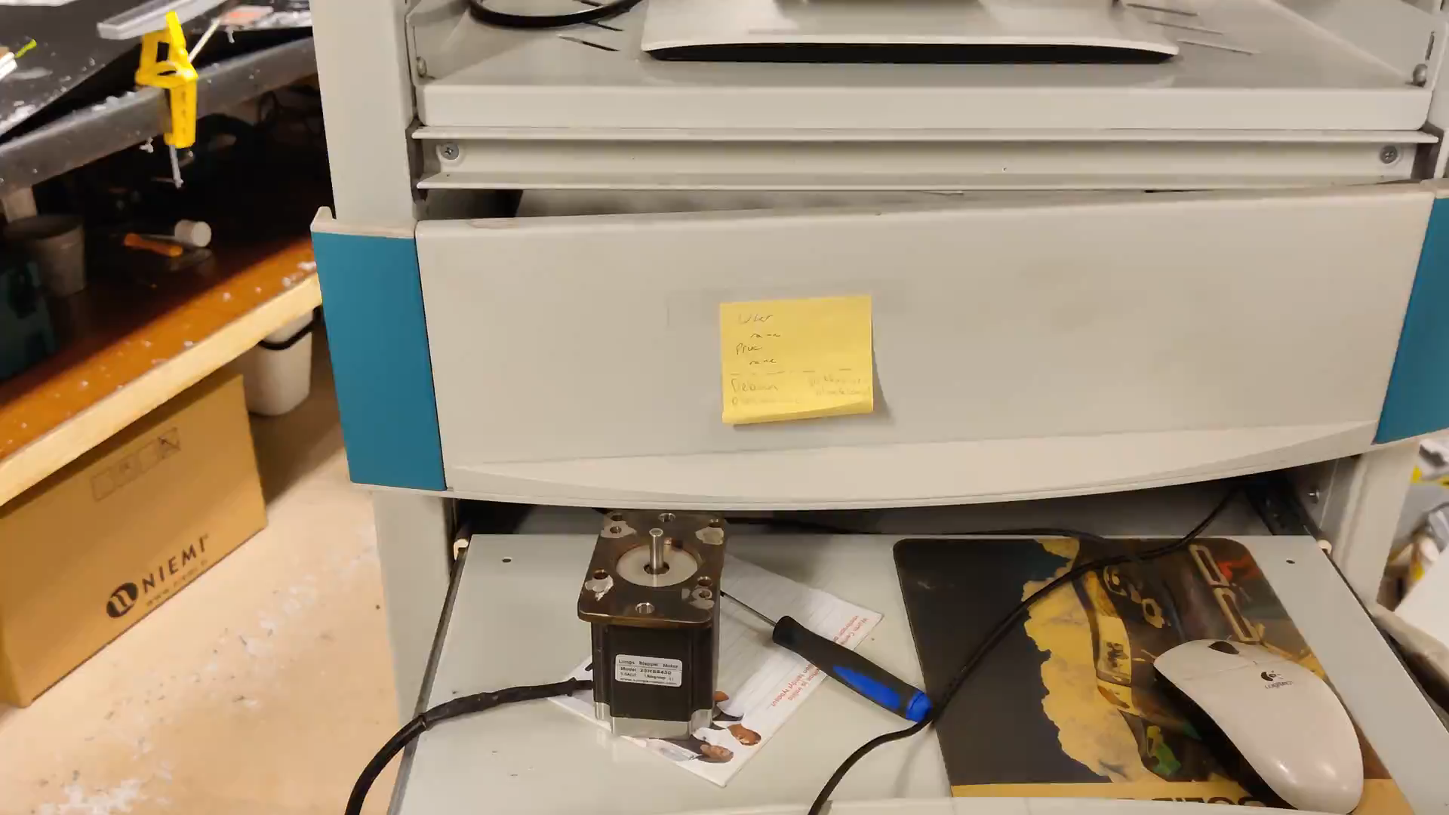

Slide 44
Servo
The origin of the word is believed to come from the French "Le Servomoteur" or the slavemotor, first used by J. J. L. Farcot in 1868 to describe hydraulic and steam engines for use in ship steering.
Latin servus = slave

Slide 45
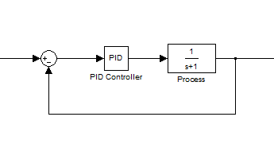
Servomotor control system
Goal:
Motor that spins at the required speed regardless of load or disturbances
Velocity feedback
Actuator that keeps at or goes to the required position regardless of load or disturbances
Position feedback

Slide 46
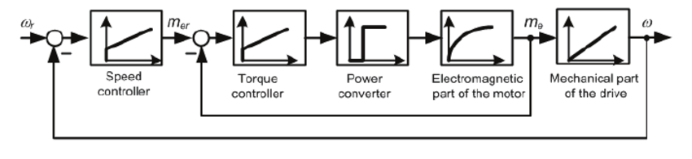
Cascade control
Control loop inside a control loop
Outer loop for speed control
Inner for torque (current)

Slide 47
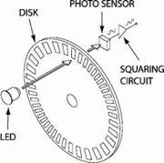
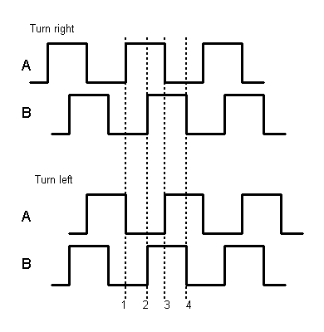
Sensors for a servo motor
Encoders
Incremental or absolute
Optical, magnetic etc.
Resolvers & Synchros
Rotating transformers which measure position
Tachogenerators
”Inverse motor”, measures rotating speed
Potentiometers
Variable voltage divider

Slide 48
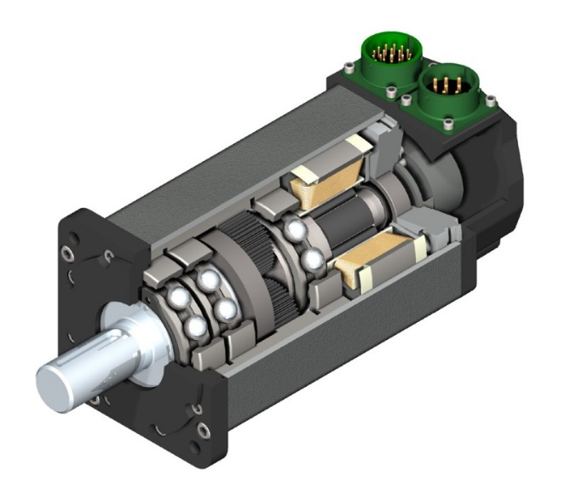
Motors for servo systems
DC (brushed or brushless)
AC (synchronous or asynchronous)
Integrated feedback sensors
Ability to tolerate short term overloads
Low inductance
Small electric time constant
Low rotor inertial mass
Small mechanical time constant
Notes:
Small electric and mechanical time constants. Small inductance of the winding and small rotor inertia.
Relation between max. torque and mass close to optimal.
Planetary reduction gear to decrease output rotation speed and increase output torque.
J = mr^2

Slide 49
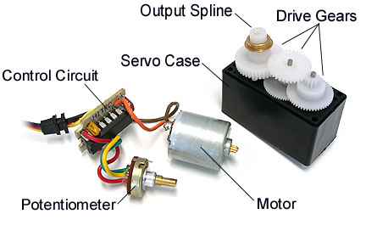
Example: RC-servo
Built in components:
Motor
Reduction gear
Potentiometer
Control circuit
Driver circuit
Notes:
Position feedback
Often velocity feedback is used

Slide 50
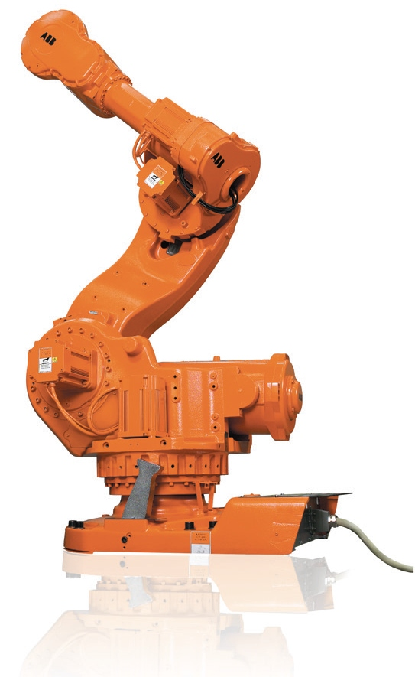
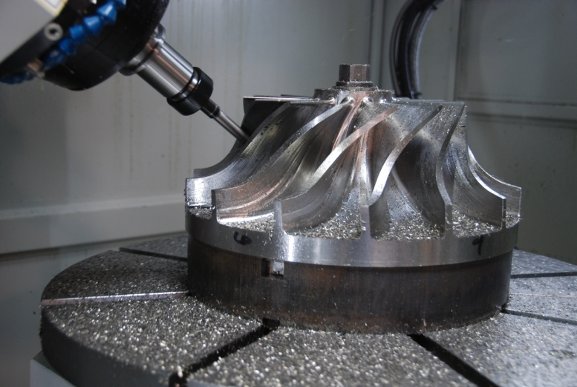
Application examples
Industrial robots
E.g. ABB IRB 7600
Payload up to 630 kg
Positioning accuracy 0.1 mm
Machining centers
Rotation to linear motion with ball screws
Positioning accuracy 0.005 mm

Slide 51
Summary
A controller increases the performance of a system
Feedback control is used to reject disturbances
Feedback control can stabilize unstable systems
Feedback control can also destabilize stable systems
A PID controller is easy to implement
Every mechatronic engineer should understand it
Servomotor is a feedback controlled motor
Servomotor is not a motor type
Notes:
PID controller is the lowest level of control. Control system in a real machine consists of several individual controllers as well as a higher level automation system.

